Slide 1

Introduction to User Interface & CSS3
13 February 2019
Kirti Kadam
‹#›

Slide 2
“UI is the saddle, the stirrups, & the reins. UX is the feeling you get being able to ride the horse.”
-Dain Miller, Web Developer
‹#›

Slide 3
Difference between UI and UX
UI stands for “User Interface” where as UX is “User Experience”, both elements are crucial to a product and work closely together.
UX is the overall experience one has with a product or service, feel of the product, which can include UI. A UI is particular about how the product is laid out, typically a combination of visual design (the look and feel) and the interaction design (how it works).
‹#›

Slide 4
What is User Interface (UI) ?
User Interface also called as UI or simply interface.
User Interface (UI) is visual part of a software application or a hardware device, which determines how a user interacts with an application or website and how information is displayed on the screen.
‹#›

Slide 5
What is UI Development? & What does a UI Developer do?
Conversion of design files (.psd, .ai or .sketch) into machine renderable format is UI development.
UI developer is one who develops User Interfaces designed by User Interface designers & team.
UI Developer's job is to convert design files (.psd, .ai or .sketch) into coding using HTML, CSS, JS languages etc. So that it can function & render well on electronic devices like computers, mobiles etc.
They are in charge of developing each screen or page with which a user interacts and ensuring that the UI visually communicates the path that a UX designer has laid out.
‹#›

Slide 6
Various available code editors
Offline Editors
Notepad ++
Atom
Visual Studio Code
WebStorm (Paid)
Online Editors
Codepen - https://codepen.io/
jsFiddle - https://jsfiddle.net/
Stackblitz - https://stackblitz.com/
CSS Deck - http://cssdeck.com/labs
..etc
‹#›

Slide 7
Various browsers - Top 5 browsers
Google Chrome - Popular Browser by Internet giant Google. Focuses on enhanced performance of web applications.
Mozilla Firefox - A web browser designed for simplicity, security, extensibility yet flexibility and power.
Opera Web Browser - Constantly evolving and improving and the most popular mobile browser.
Safari Web Browser - Safari is a web browser developed by Apple inc. It is the most popular browser with MAC users.
Internet Explorer - Internet Explorer by Microsoft is the default browser for Windows operating system.
‹#›

Slide 8
HTML Cheatsheet
As we are not covering HTML, here. Is a link which covers HTML tags with short explanation and example.
https://www.december.com/html/spec/HTML5-Cheat-Sheet.pdf
‹#›

Slide 9
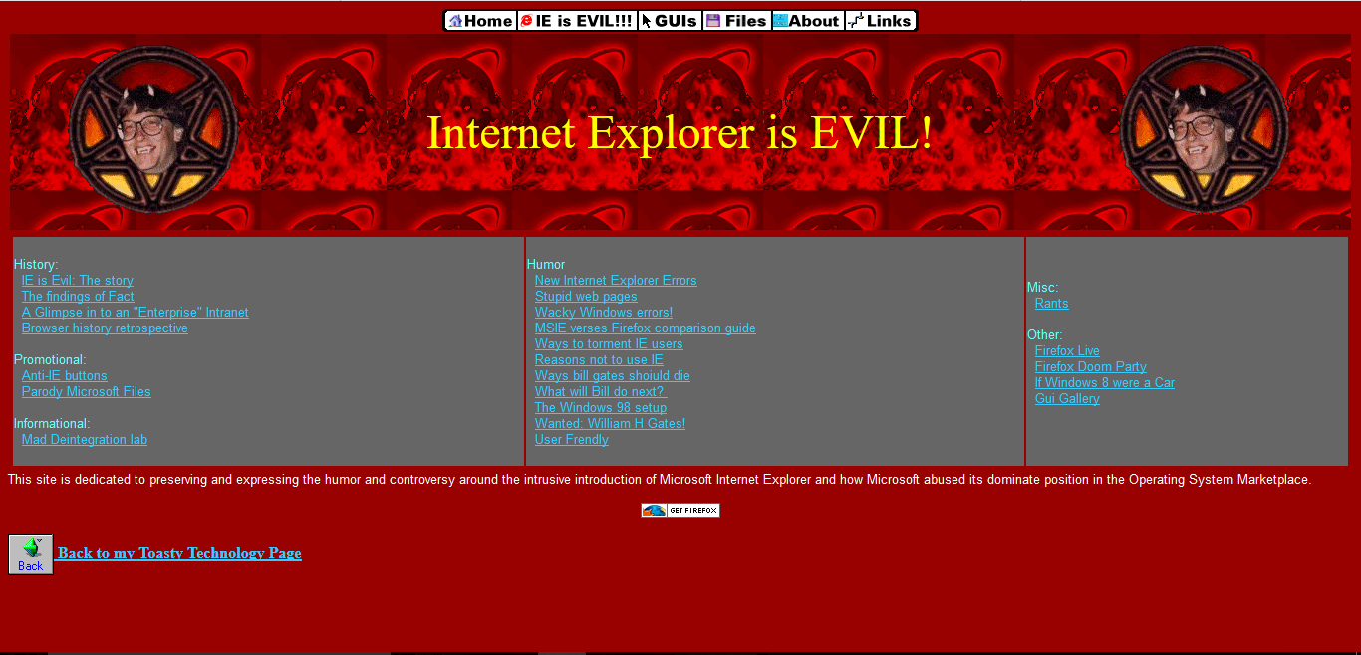
Introduction to CSS
‹#›

Slide 10
Cascading Style Sheets
Inline
use the style attribute in HTML elements
Internal
use a <style> element in the <head> section
External
use an external CSS file
‹#›

Slide 11
CSS Syntax
Grammar of the CSS Language!
What?
selector { property : value; }
Who?
How?
‹#›

Slide 12
Selectors
Selector Name | Syntax | Example/Description
Universal Selector | *{ } | Selects all elements
Type selector | element { } | “p” selects all <p> elements
Class Selector | .[class_name] { } | “.intro” selects all elements with class=”intro”
ID Selector | #[ID_name] { } | “#main” selects the element with id=”main”
Descendant selector | element1 element2 { } | “div p” selects all <p> elements inside <div> elements
Child selector | element1 > element2 { } | “div > p” selects all <p> elements where the parent is a <div> elements
Adjacent sibling selectors | element1 + element2 { } | “div + p” selects all <p> elements that are placed immediately after <div> elements
Attribute selectors | element1[attr=”val”] { } | “input[type="text"]” select all <input> elements with type=”text”
‹#›

Slide 13
List of Selectors
Selector Name | Syntax | Example/Description
Pseudo classes For Eg- :disabled :hover | [tag_name]:disabled { } [tag_name]:hover { } | “input:disabled” selects every disabled <input> element
Pseudo elements For Eg- :before :first-letter | [tag_name]:before { } [tag_name]:first-letter { } | Insert something before the content of each <p> element
‹#›

Slide 14
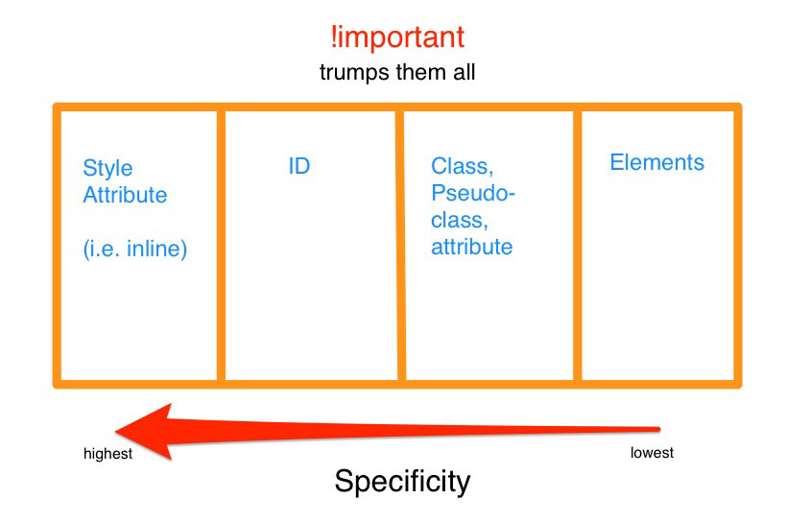
Specificity
If two CSS selectors apply to the same element, the one with higher specificity wins
Every selector has its place in specificity hierarchy.
There are four categories which define specificity level of a given selector: inline styles, IDs, classes, attributes, and elements.
If selectors have an equal specificity value, latest rule is the one that counts.
If selectors have an unequal specificity value, more specific rule is the one that counts
‹#›

Slide 15
Box Model
Total Width
Content
400
+
Padding (L/R)
15 + 15
+
Border (L/R)
0 + 0
+
Margin (L/R)
10 + 10
=
Total 450
Total Height
Content 100
margin
10
+
border
-
Padding (T/B) 15 + 15
padding
+
15
content
400 x 100
Border (T/B) 0 + 0
10
-
15
15
-
10
+
Margin (T/B) 10 + 10
=
15
Total 150
-
10
‹#›
Notes:
Explain with example box size calculation - we set width = 400px, padding=15px, border=0px, margin=10px. Now the actual size of box(element) will be 450px.
Similarly for height, if set 100px, actual will be 150px.

Slide 16
Box Model
Outline property always goes around all the sides, you can’t specify one particular side.
It does not affect position of element or adjacent elements as it is not part of box model.
margin
10
border
-
padding
content
400x100
10
-
15
15
-
10
-
10
Outline Property - Highlighted in red color
http://markusvogl.com/web1/interactive_box_model/css_box_demo.html
‹#›

Slide 17
Display - https://codepen.io/Kirti306/pen/xMGBxZ
The display property specifies the display behavior (the type of rendering box) of an element.
Block - <p>, <h1> to <h6>, <div>, <ol>, <ul>, <li> and <form>
Inline - <span>, <img> and <a>
Inline-Block
None
Visibility - hidden, visible
‹#›

Slide 18
Wayback Machine
The Wayback Machine is a digital archive of the World Wide Web and other information on the Internet. It was launched in 2001 by the Internet Archive, a nonprofit organization based in San Francisco, California, United States.
Wayback Machine - https://archive.org/web/
‹#›
Notes:
Share template with participants and explain the things they need to do.

Slide 19
Position - https://codepen.io/Kirti306/pen/jdrNdm?editors=1100
Position property is used to position elements on the screen in the way you want to instead of going with the default layout.
Static - All elements are static by default, it means going with the default HTML flow. This is what we see when we just have HTML without any CSS.
Relative - Positions the element relative to how it would have been positioned had it been static.
Absolute - Positions the element, relative to the parent.
Fixed - Positions the element relative to the viewport. So, event if you scroll element stays at the same place.
‹#›

Slide 20
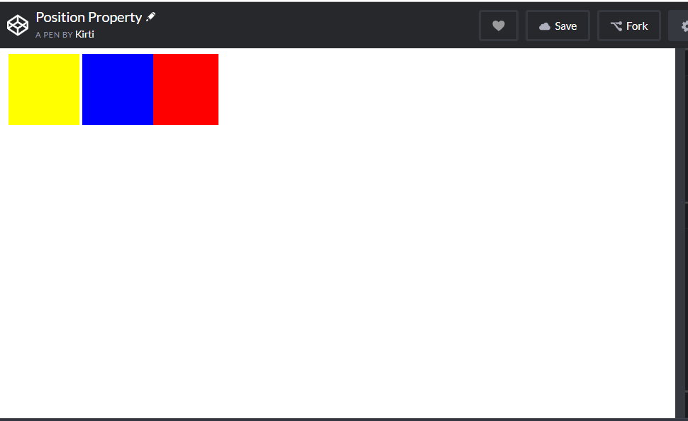
Challenge 1 - Place blocks using “position: relative” in below form
‹#›

Slide 21
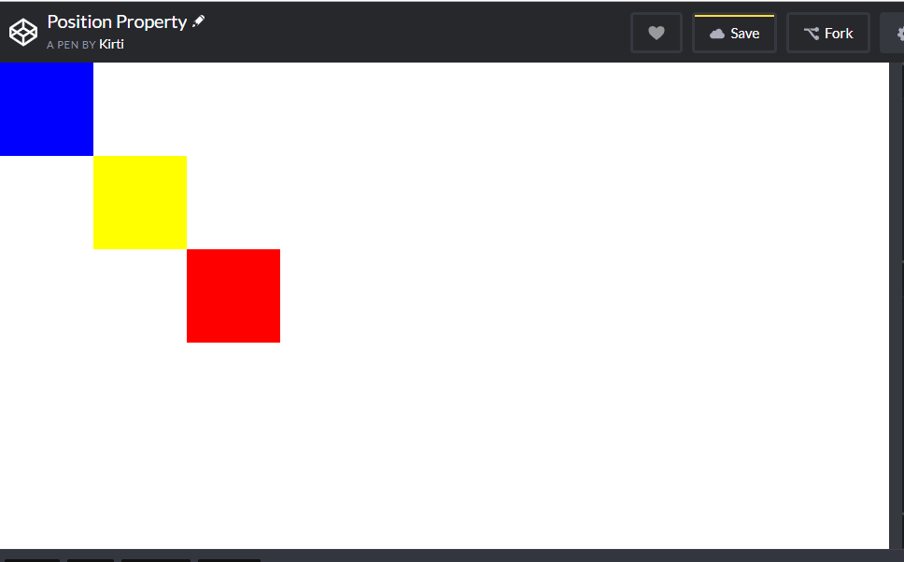
Challenge 2 - Place blocks using “position: absolute” in below form
‹#›

Slide 22
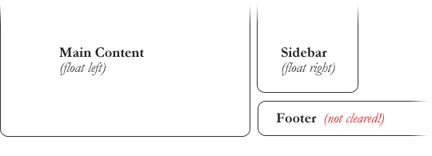
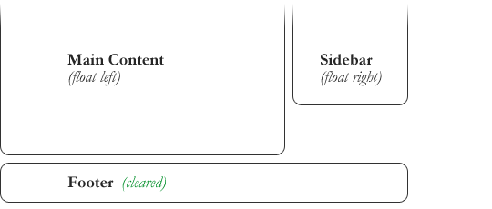
Float - https://codepen.io/Kirti306/pen/ZwLXNQ?editors=1100
Float property specifies that element should be taken from normal flow and placed along left or right side of its container.
What are floats used for?
Wrapping text around images.
To create entire web layouts.
Clearing the float:
An element that has clear property set on it will not move up adjacent to float like the float desires, but will move itself down past the float.
‹#›

Slide 23
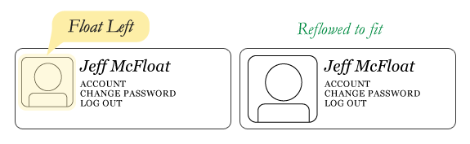
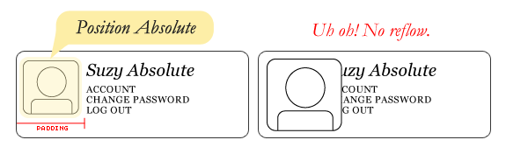
float:left vs position:absolute
‹#›

Slide 24
Centering elements - https://codepen.io/Kirti306/pen/BMQLYJ?editors=1100
A common task in CSS is to center text or images.
Centering lines of text - The most common and easiest type of centering is that of lines of text in a paragraph or in a heading. CSS has the property 'text-align'.
Centering a block or image - Sometimes it is not the text that needs to be centered, but the block as a whole. Or, we want the left and right margin to be equal.
Centering Vertically - Use the 'transform' property to center an absolutely positioned element.
Centering Horizontally & Vertically - The stylesheet is similar to the previous example with respect to the vertical centering. But we now move the element halfway across the container as well.
‹#›

Slide 25
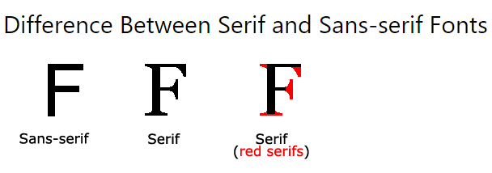
Fonts
CSS Font Stack - https://www.cssfontstack.com/
Google Fonts - https://fonts.google.com/
‹#›

Slide 26
Auto prefix - https://autoprefixer.github.io/
Autoprefixer is a PostCSS plugin which parse your CSS and add vendor prefixes. The autoprefixer uses data on the popularity of browsers and support for vendor prefixes by browsers. Based on this information, it arranges and deletes the prefixes.
Vendor prefixes - are a way for browser makers to add support for new CSS features before those features are fully supported in all browsers
The major browsers use the following prefixes:
-webkit- (Chrome, Safari, newer versions of Opera, almost all iOS browsers (including Firefox for iOS); basically, any WebKit based browser)
-moz- (Firefox)
-o- (Old, pre-WebKit, versions of Opera)
-ms- (Internet Explorer and Microsoft Edge)
‹#›
Notes:
.example {
display: flex;
background: #E3FFD2;
transition: all 0.5s;
background: linear-gradient(to bottom, white, black);
}

Slide 27
Color - https://codepen.io/Kirti306/pen/ZwyaqG
CSS uses color values to specify a color.
Format | Syntax | Example
Keyword | aqua, black, etc. | p{ color: teal; }
Hex Code | #RRGGBB | p{ color: #FF0000; }
Short Hex Code | #RGB | p{ color: #6A7; }
RGB % | rgb(rrr%,ggg%,bbb%) | p{ color: rgb(50%,50%,50%); }
RGB Absolute | rgb(rrr,ggg,bbb) | p{ color: rgb(0,0,255); }
‹#›

Slide 28
Color
CSS3 has Supported additional color properties
Opacity - Transparency level of an element.
p { background-color: rgb(0,0,255); opacity: 0.6; }
Format | Syntax | Example
RGBA | rgba(rrr,ggg,bbb,a) | p{ color: rgb(0,0,255,0.5); }
HSL | hsl(h, s%, l% ) | p{ color: hsl(120, 100%, 50%); }
HSLA | hsla(h, s%, l%, a ) | p{ color: hsl(120, 100%, 50%, 0.3); }
‹#›

Slide 29
Gradient - https://codepen.io/Kirti306/pen/xMRrPa?editors=1100
CSS gradients let you display smooth transitions between two or more specified colors.
CSS defines two types of gradients:
Linear Gradients (goes down/up/left/right/diagonally)
background-image: linear-gradient(direction, color-stop1, color-stop2, ...);
Radial Gradients (defined by their center)
background-image: radial-gradient(shape size at position, start-color, ..., last-color);
‹#›

Slide 30
Box shadow - https://www.cssmatic.com/box-shadow
The box-shadow CSS property adds shadow effects around an element's frame.
box-shadow: none|h-offset v-offset blur spread color;
Example
box-shadow: 0px 0px 8px 2px rgba(0,0,0,0.55);
Inside shadow example
box-shadow: inset 0px 0px 8px 2px rgba(0,0,0,0.55);
‹#›

Slide 31
2D & 3D Transform - https://codepen.io/Kirti306/pen/PVbeWp?editors=1100
CSS transforms allow you to translate, rotate, scale, and skew elements. A transformation is an effect that lets an element change shape, size and position. Using with 3d transforms, we can move element to x-axis, y-axis and z-axis
Common methods used for transform are listed below
translate() - moves an element from its current position.
rotate() - rotates an element clockwise or counter-clockwise according to a given degree.
scale() - increases or decreases the size of an element.
skewX() - skews an element along the X-axis by the given angle.
skewY() - skews an element along the Y-axis by the given angle.
‹#›

Slide 32
Transition - https://codepen.io/Kirti306/pen/exRJJg
CSS transitions allows you to change property values smoothly (from one value to another), over a given duration.
To create a transition effect, you must specify two things:
the CSS property you want to add an effect to
the duration of the effect
Syntax
transition: property duration timing-function delay|initial|inherit;
‹#›

Slide 33
Animation - https://codepen.io/team/css-tricks/pen/EjaJNd
The animation property in CSS can be used to animate many other CSS properties such as color, background-color, height, or width. Each animation needs to be defined with the @keyframes at-rule which is then called with the animation property
Syntax
animation: name duration timing-function delay iteration-count direction fill-mode play-state;
Which properties can be animated?
‹#›

Slide 34
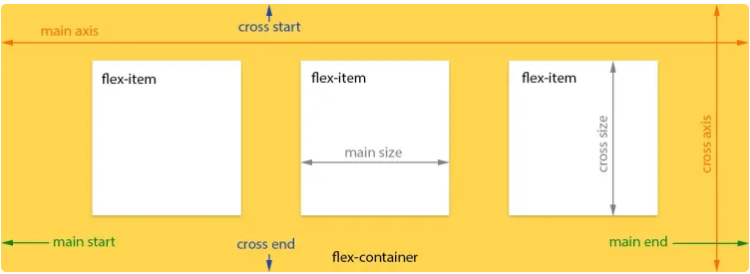
Flexbox - https://codepen.io/justd/full/yydezN/
Flexbox is new layout module in CSS3 made to improve the items align, directions and order in the container even when they are with dynamic or even unknown size.
The flex layout is constituted of parent container referred as flex container and its immediate children which are called flex items.
‹#›

Slide 35
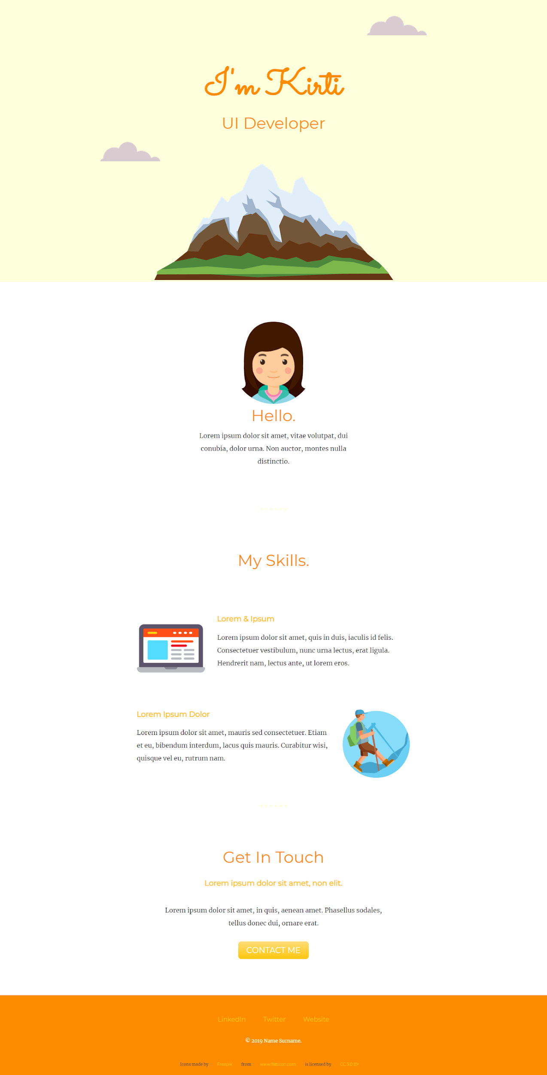
Creating our CV website
‹#›

Slide 36
Favicon
When people were using IE5 - Favicon was an icon which would show up on a website that you have favorited. And for web developers it would give an estimate of how many people have favorited or bookmarked your website. But now it doesn't work anymore, as browsers would show favicon anyway whether favorited or not. But it's a nice touch to have.
Create your own Favicon - www.favicon.cc
‹#›

Slide 37
Questions?
‹#›

Slide 38
References
Browser List - https://www.slimjet.com/en/lp/top-10-browsers.php
Editors List - https://mythemeshop.com/blog/code-editors/
Online Web Editors - https://www.awwwards.com/10-html-css-online-code-editors-for-web-developers.html
MDN Web Docs - https://developer.mozilla.org/en-US/docs/Web/CSS
w3schools - https://www.w3schools.com/css/
Dev Docs - https://devdocs.io/
W3C - https://www.w3.org/Style/CSS/
Color Palettes - https://colorhunt.co/
CodePen - https://codepen.io
Flat Icons - https://www.flaticon.com/
Pesticides - https://chrome.google.com/webstore/detail/pesticide-for-chrome/bblbgcheenepgnnajgfpiicnbbdmmooh
‹#›

Slide 39
Tomorrows session..
RWD with Bootstrap
Please go through https://getbootstrap.com/ to have basic idea about what things we are going to learn tomorrow.
‹#›

Slide 40
Thank You!
You can find me at
Skype - kirti.kadam306
Email - kirti.kadam@synerzip.com
‹#›

